Slide 1
Maximum likelihood estimation

Slide 2

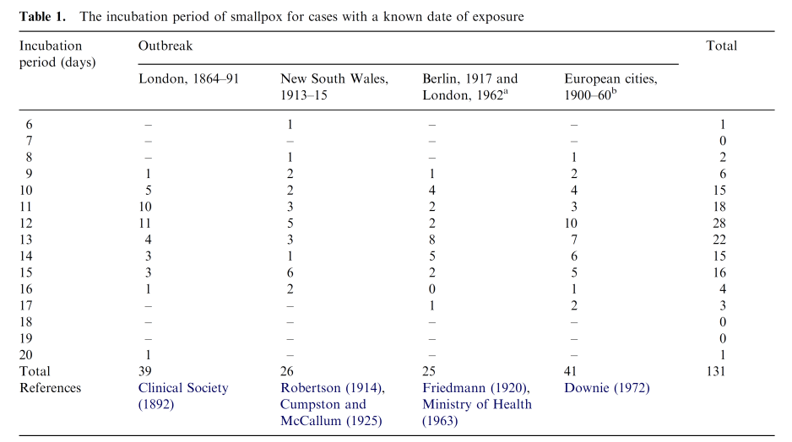
Smallpox incubation period data

Slide 3
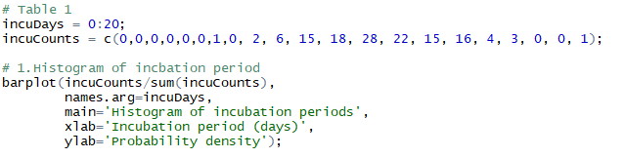
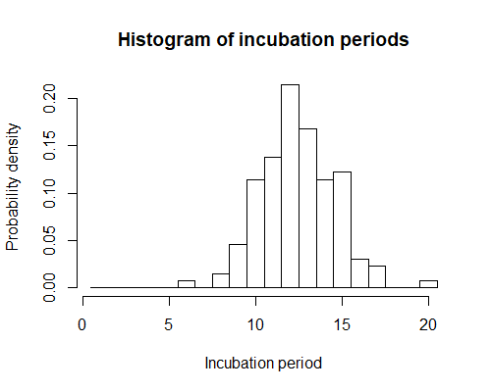
Smallpox incubation period data
What is the best fit distribution if the incubation period follows a log-normal distribution?

Slide 4

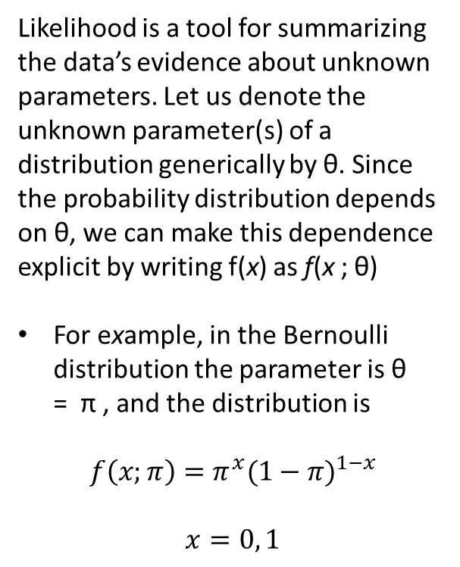
Likelihood
Likelihood is a tool for summarizing the data’s evidence about unknown parameters. Let us denote the unknown parameter(s) of a distribution generically by θ. Since the probability distribution depends on θ, we can make this dependence explicit by writing f(x) as f(x ; θ)
For example, in the Bernoulli distribution the parameter is θ = π , and the distribution is
$$f\left(x;π\right)=π^{x}{(1−π)}^{1−x}$$
$$x=0, 1$$
For example, if we observe X = 1, then plugging x = 1 gives the function π . If we observe X = 0, the function becomes 1 − π .
Whatever function of the parameter we get when we plug the observed data x into f(x ; θ), we call that function the likelihood function.

Slide 5
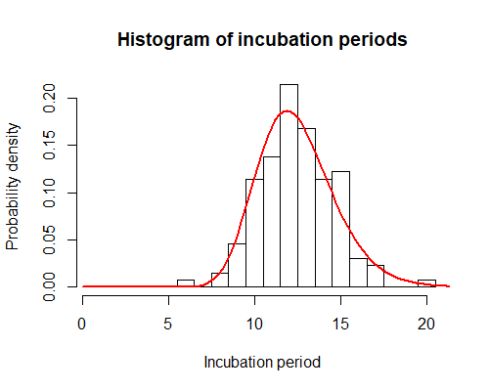
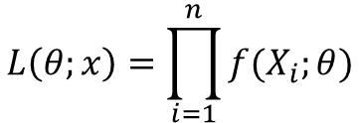
Maximum-likelihood estimation
Whatever function of the parameter we get when we plug the observed data x into f(x ; θ), we call that function the likelihood function.
$$L\left(θ;x\right)=\prod_{i=1}^{n}{f(X_{i};θ)}$$
What is the best fit distribution if the incubation period follows a log-normal distribution?
It’s reasonable to estimate an unknown parameter θ by the value for which the likelihood function L(θ ; x) is largest. This approach is called maximum-likelihood (ML) estimation.

Slide 6

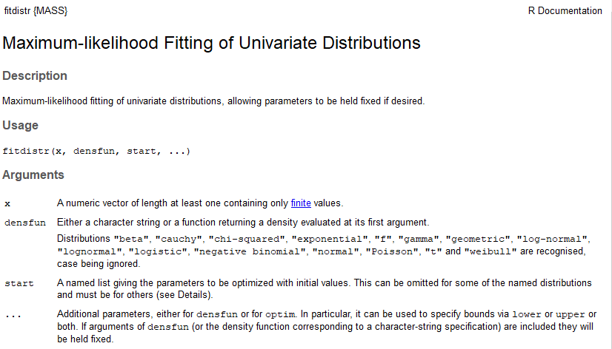
MLE using “fitdistr” in R
Call “fitdistr” in R. For only a few distributions

Slide 7
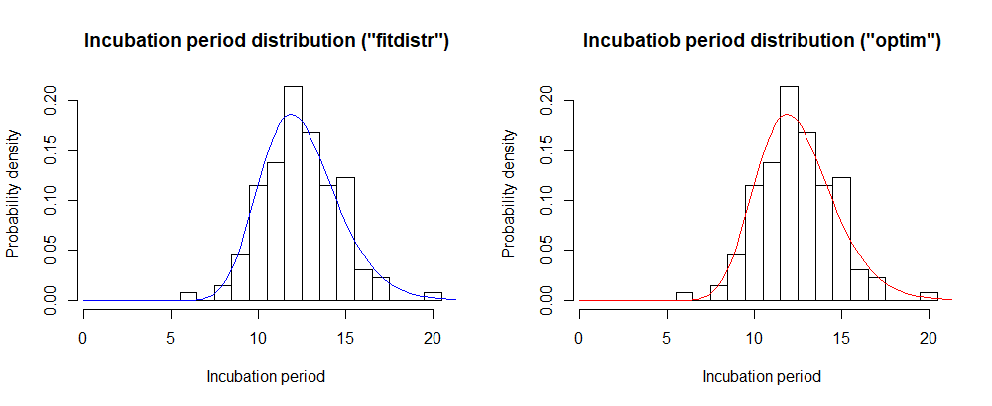
MLE of incubation period distribution

Slide 8
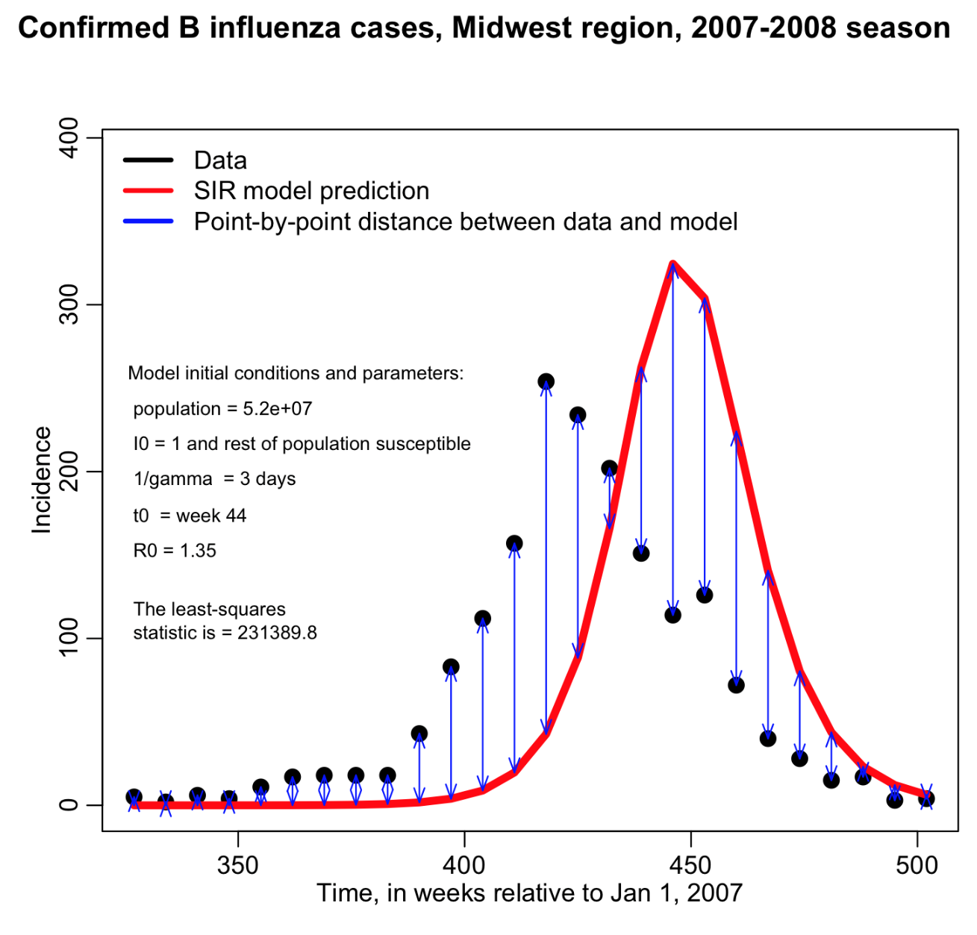
Fit an epidemic

Slide 9
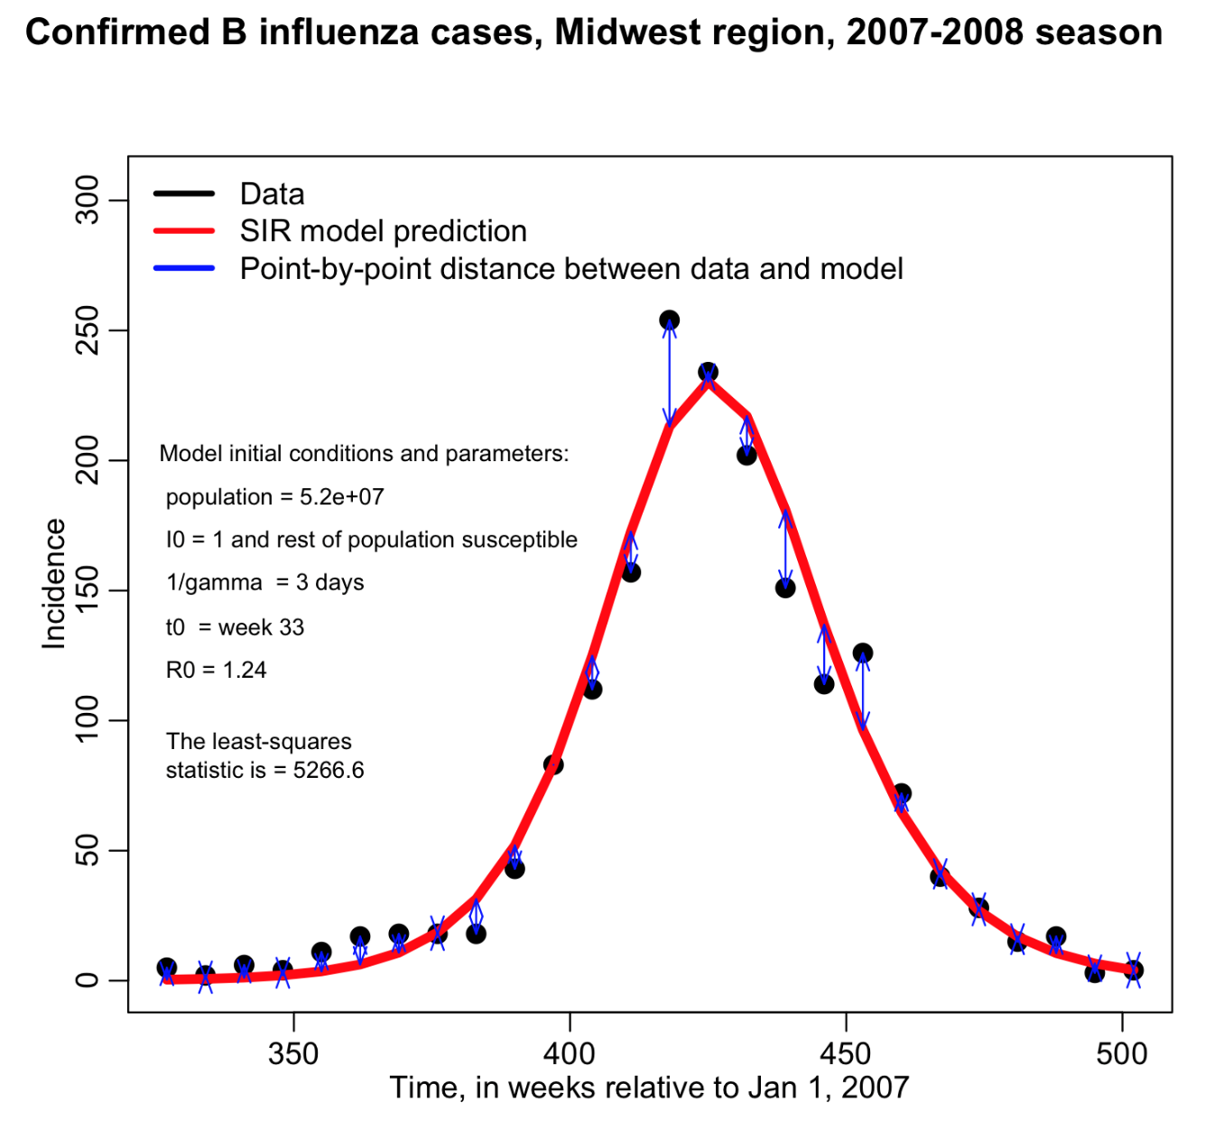
Fit an epidemic

Slide 10
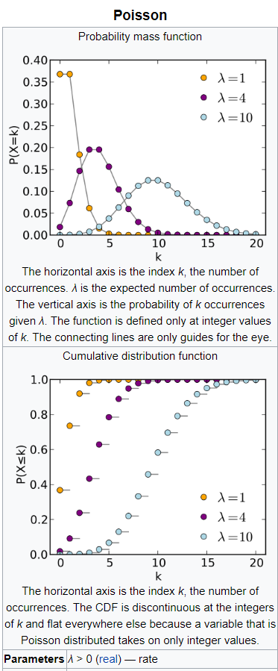

Define a likelihood function?
Poisson distribution is a discrete distribution to describe the occurrence of “unlikely” events in a large number of repeated trials.

